Slide 1


Department of Computer Science and Engineering
GE19612 – PROFESSIONAL READINESS FOR INNOVATION EMPLOYABILITY AND ENTREPRENEURSHIP
Chatbot to assist users with Government Schemes
Dr.T.KumaragurubaranProfessor
A.Aakash
210701002
P.Arvind
210701034

Slide 2
Abstract
In our rapidly evolving technological landscape, accessing government schemes can be daunting for many citizens due to bureaucratic complexities. To address this challenge, we propose an AI chatbot solution developed using MERN Stack technology and Python scripts for web scraping. By leveraging Open Source Transformer models for Natural Language Processing, our chatbot aims to provide personalized assistance in understanding, assessing eligibility for, and applying to government schemes. Unlike existing systems reliant on manual browsing, our solution automates information retrieval and streamlines the user experience. With features like user authentication, eligibility assessment, and proactive notifications, our chatbot represents a significant advancement in citizen engagement with public services, fostering transparency and inclusivity.

Slide 3
Existing System
In the current system, accessing information about government schemes involves manual browsing of various decentralized sources such as government websites and documents. Users face challenges due to fragmented information, lack of personalized assistance, and limited interactivity. This results in inefficiencies, confusion, and difficulties in assessing eligibility and tracking updates. Overall, the existing system lacks centralized access, personalized guidance, and proactive notification features, hampering citizen engagement with government schemes.

Slide 4
Proposed System
The proposed system introduces an AI-driven chatbot solution aimed at citizen access to government schemes. Using technologies such as the ERN Stack and Python scripts for web scraping, the chatbot integrates with diverse government sites and online resources. Powered by Open Source Transformer models for Natural Language Processing (NLP), it provides personalized assistance tailored to individual queries and needs. Unlike the existing manual browsing approach, the chatbot automates information retrieval, aggregating, analyzing, and presenting relevant data in a user-friendly format. By bridging the gap between citizens and government schemes, the proposed system fosters transparency, inclusivity, and accessibility, empowering individuals to make informed decisions and access entitled benefits efficiently in a seamless and equitable manner.

Slide 5
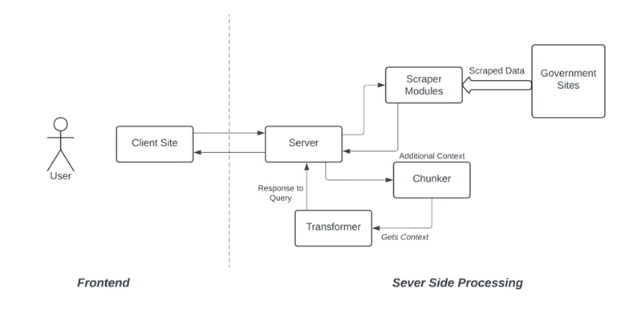
System Architecture

Slide 6
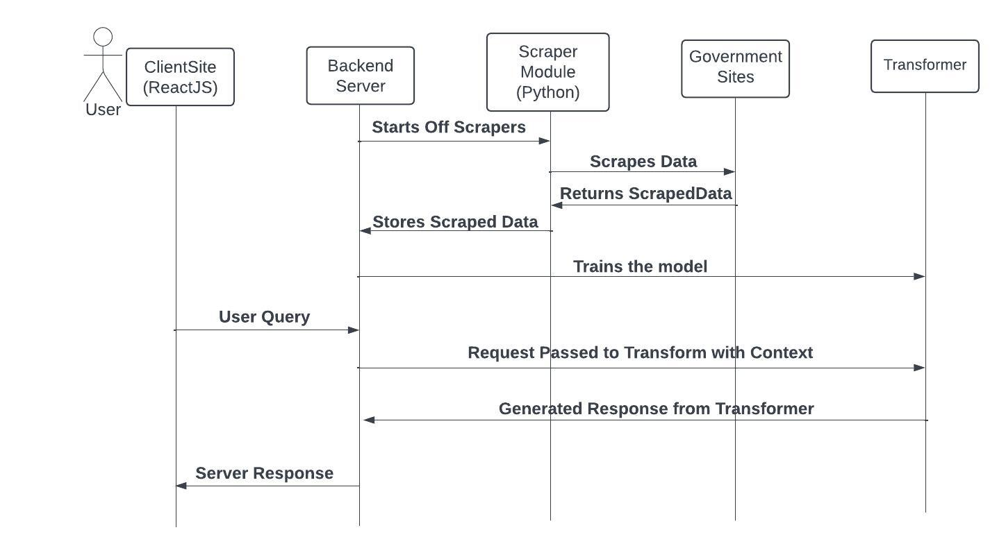
Sequence Diagram

Slide 7
List of Modules
Scraper Module
Chunker Module
API Interface Module
Frontend Module

Slide 8
Functional Description for each modules
Scraper Module:
The ‘Scraper’ module’s primary use is to scrape government sites to collect data. As there’s no single API endpoint for all government schemes we proceeded with building a dedicated scraping module. This scraper module is written on Python 3 and uses ‘Beautiful Soup 4’ module to traverse the DOM of the site and scrap the required data. The scraped data is then written onto the server itself as a JSON file for further processing. The extracted fields are:
- Elibility Criteria
- Government
- Description and other important fields

Slide 9
Functional Description of Module
API Interface Module:
The API module (api.py) acts as the interface to our Pre Trained transformer model. This transformer model is based off of GPT-3.5 Turbo. As these transformers are capable of Natural Language Generation and Understanding, these are the perfect choices for our chatbots. This module essentially collects the scraped data and passes the raw JSON data to the transformer model as a context. After getting trained with the JSON the model is then finetuned. Then the module is read to answer query from the frontend client.

Slide 10
Functional Description of Module
Chunker Module:
Since these transformer cannot process a large amount of context all at once, the large raw JSON dataset is then further split into many ‘chunks’ to be sent to the transformer model. This module takes the Raw dataset as input and splits it into chunks of a specified size, and stores each chunk in separate JSON files (preprompt_ds_X.json). After the process the original dataset is removed.

Slide 11
Functional Description of Module
Frontend Module:
The frontend module is built in React JS, making use of ‘axios’ library to connect with the Backend server. This module consists of a Chat area for the request and response chats to be displayed . Also it has a textbox with a send button for typing queries and submitting it. The user can straightaway start asking their government scheme related queries and the reponse will be displayed to the frontend from the backend server.
Additionally the Frontend also has Markdown support for formatting the Text.

Slide 12
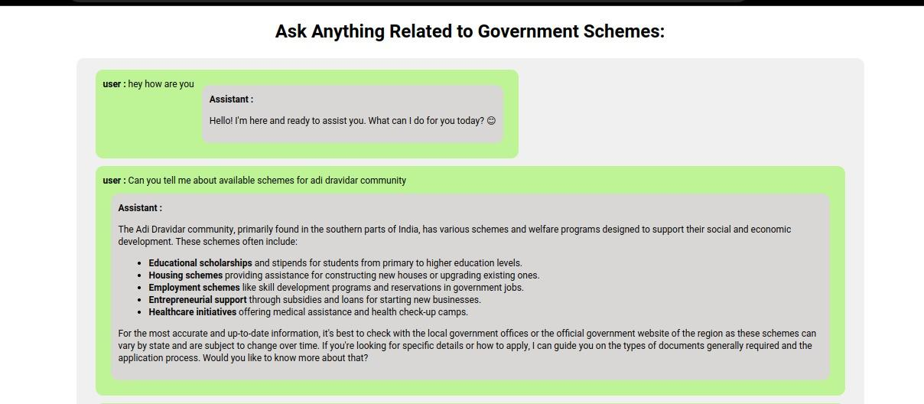
Implementation

Slide 13
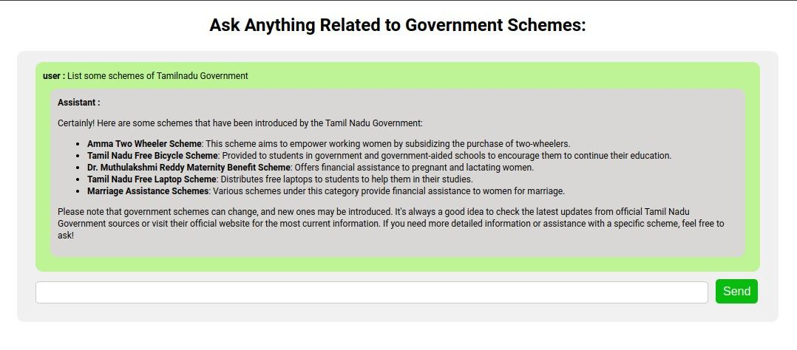
Implementation

Slide 14
Conclusion
In conclusion, our project significantly enhances citizen access to government schemes through AI-driven chatbot technology and web scraping. By streamlining information retrieval and providing personalized assistance, our solution improves user experience and fosters transparency in citizen-government interactions. With features like user authentication and proactive notifications, our system offers an efficient pathway for citizens to access benefits. Moving forward, we are committed to expanding our system's capabilities and empowering individuals to navigate government schemes with confidence and ease.

Slide 15
References
"Deep Learning" by Ian Goodfellow, Yoshua Bengio, and Aaron Courville.
"Neural Networks and Deep Learning: A Textbook" by Charu C. Aggarwal.
"Deep Learning for Computer Vision" by Rajalingappaa Shanmugamani.
"Hands-On Machine Learning with Scikit-Learn, Keras, and TensorFlow" by Aurélien Géron.
"Deep Learning: A Practitioner's Approach" by Adam Gibson and Josh Patterson.

Slide 16
Thank You

